Slide 1
Installing git

Slide 2

What is Git?
Git is a free and open source distributed version control system designed to handle everything from small to very large projects with speed and efficiency.
(https://git-scm.com)
So you can track all work processes.

Slide 3
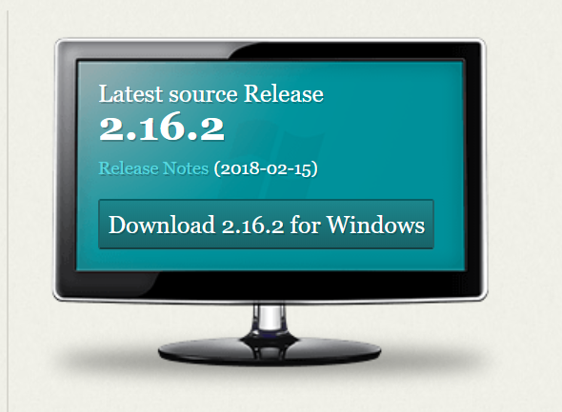

Access to Git official website and download the latest version
https://git-scm.com
or
Download from HisNet
Click.
Then the installation will be started automatically.

Slide 4
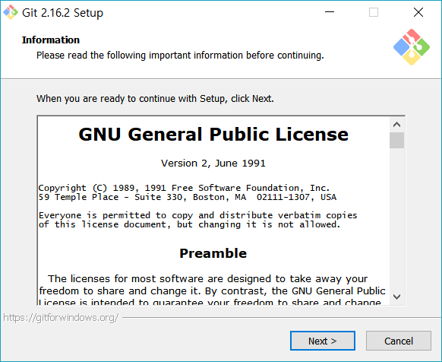
Installing git

Slide 5
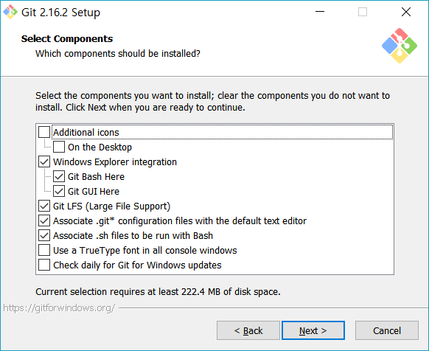
Installing git
If you want add icons on your Desktop,
you can check ‘additional icons’ and ‘On the Desktop’

Slide 6
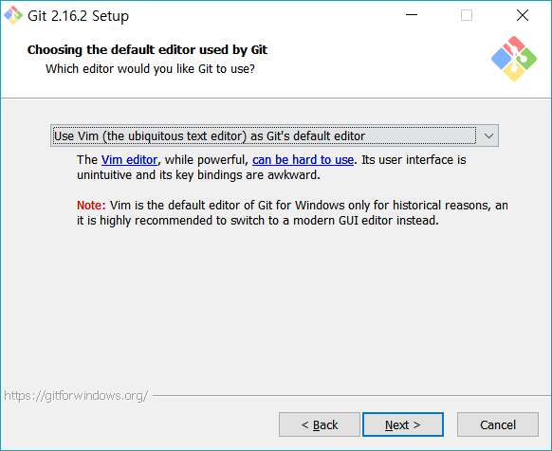
Installing git
There are other options.
But using Vim is recommended.

Slide 7
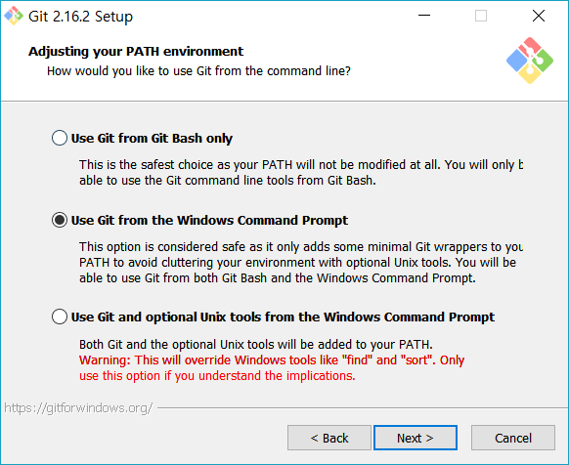
Installing git
Check
‘Use Git from the Windows Command Prompt’

Slide 8
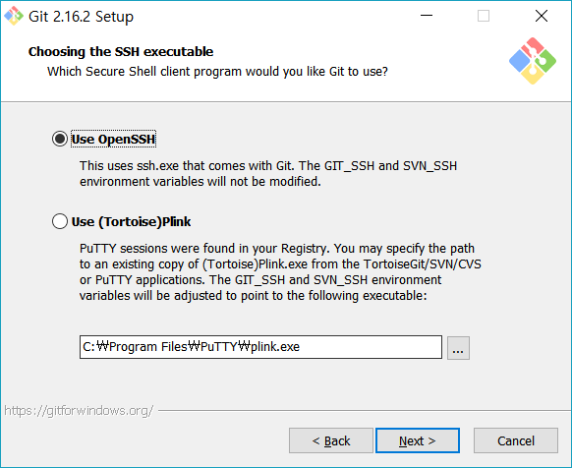
Installing git

Slide 9
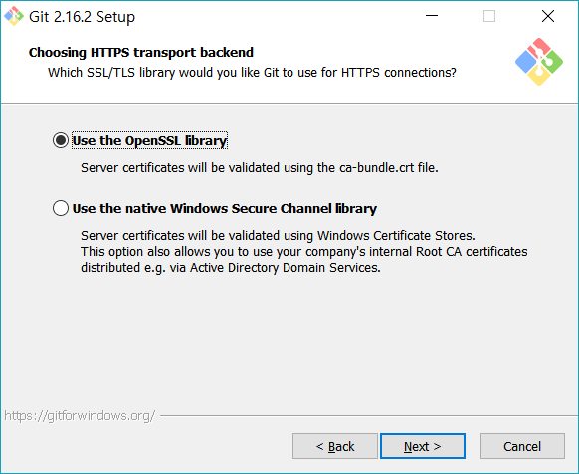
Installing git

Slide 10
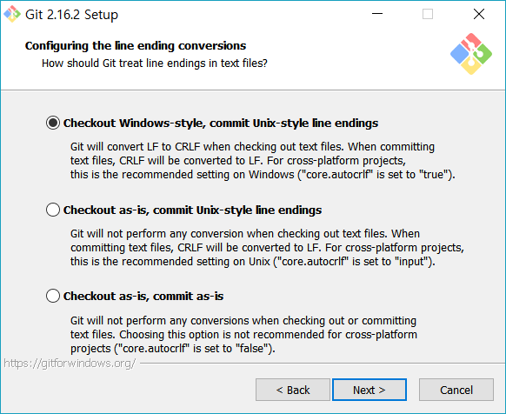
Installing git

Slide 11
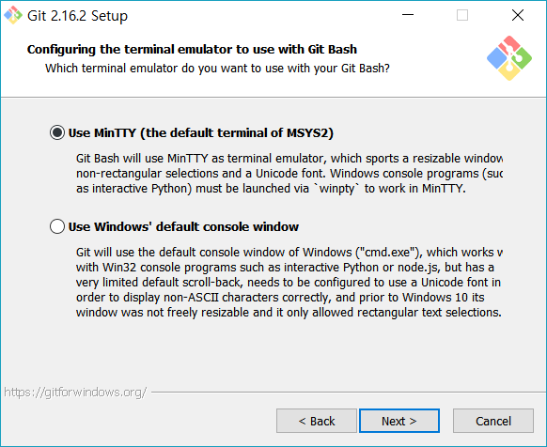
Installing git

Slide 12
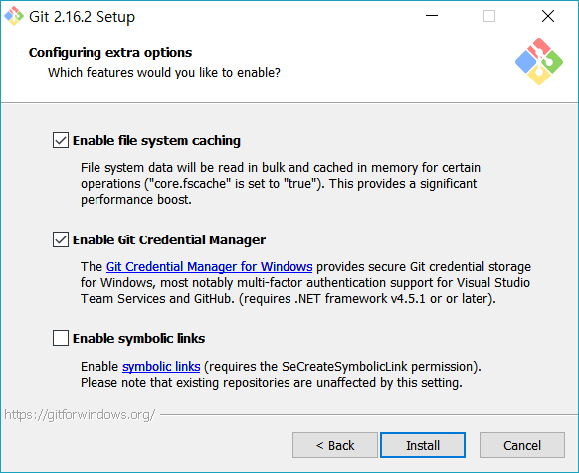
Installing git

Slide 13
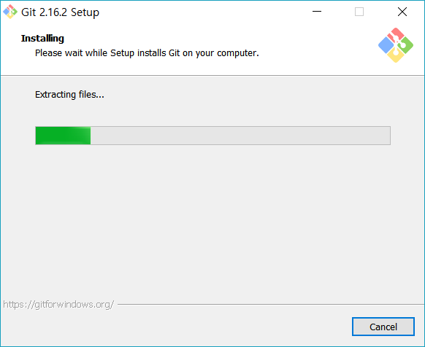
Installing git

Slide 14
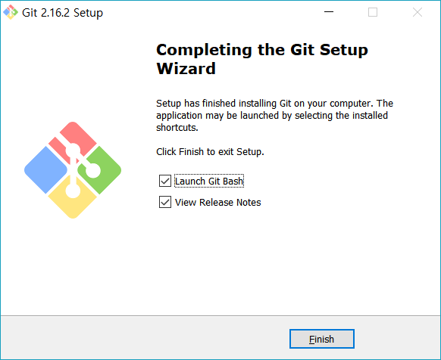
Finished installing Git

Slide 15
Github

Slide 16

Create an account
Connect to https://github.com/ and click the green button

Slide 17
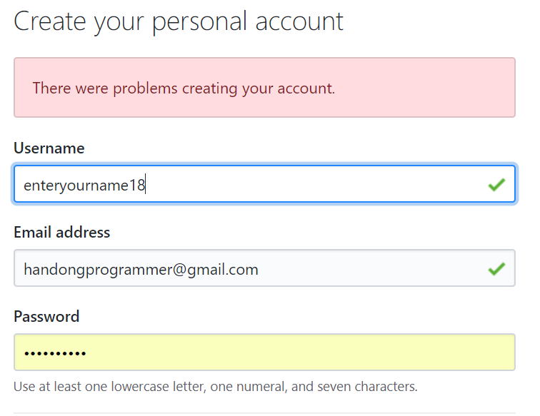

Create an account

Slide 18
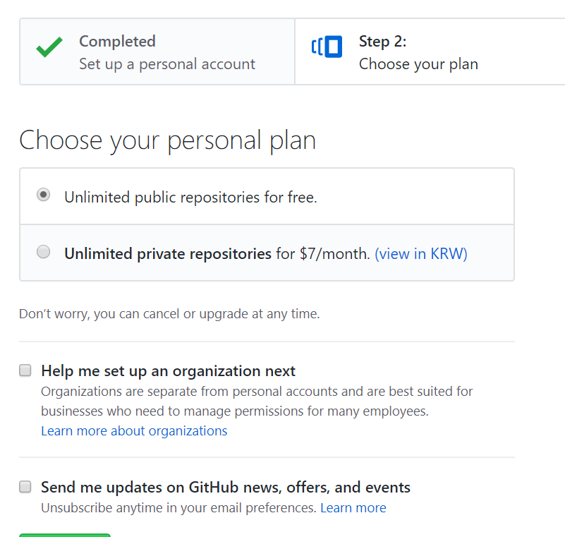

Create an account
Then,Verify your email address.

Slide 19
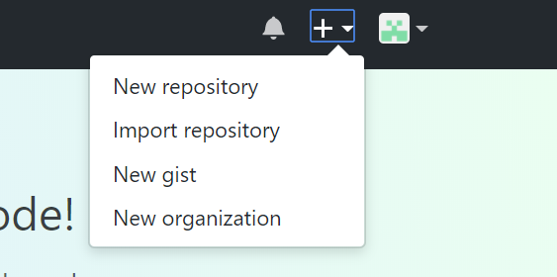
Create your remote repository

Slide 20
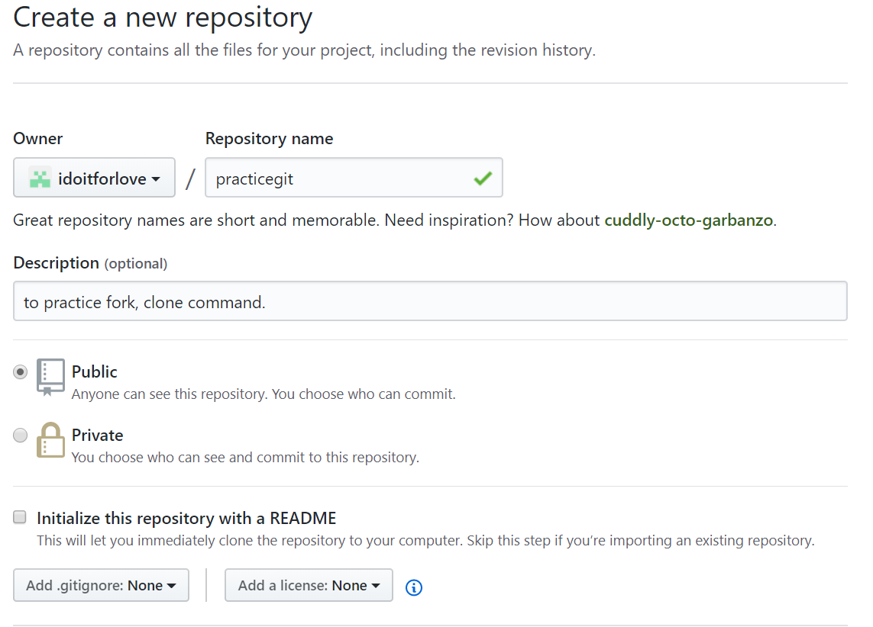

Create your remote repository (2)
The repository name is YOUR CHOICE. If you have to do labs or HWs with a specific repository name, use that name when you create the git repository!! The 'practicegit' is an example name. Do not use it for you labs and HWs. Please aware of what you are doing now.

Slide 21

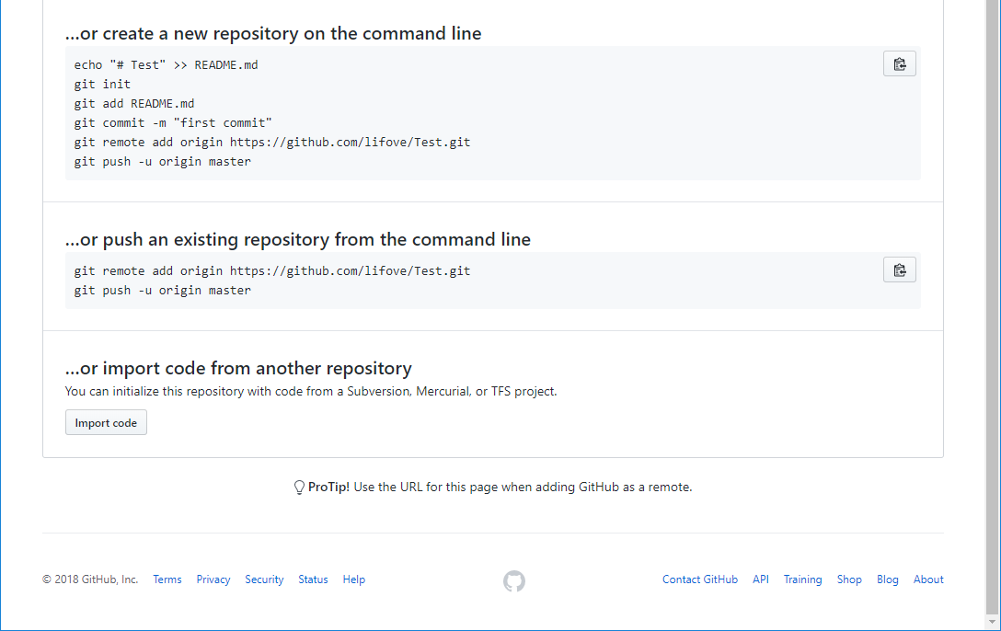
Create your remote repository (3)
Now you can check your own remote repository address.

Slide 22
Create your local repository: Do this in CMD
E:\> mkdir git
E:\> cd git
E:\git> mkdir Test
E:\git> cd Test
E:\git\Test> echo "# Test" >> README.md
E:\git\Test> git init
Initialized empty Git repository in E:/git/Test/.git/
E:\git\Test> git add README.md
E:\git\Test> git commit -m "first commit"
*** Please tell me who you are.
Run
git config --global user.email "you@example.com"
git config --global user.name "Your Name"
to set your account's default identity.
Omit --global to set the identity only in this repository.
fatal: unable to auto-detect email address (got 'user@DESKTOP-OJ184AA.(none)')
E:\git\Test> git config --global user.email "your@email.address"
E:\git\Test> git config --global user.name "Your Name"
E:\git\Test> git commit -m "first commit"
<< Create your project directory. In this example, the directory name is "Test".
<< Change directory to "Test". Please use the git repository name you created in Github. The project name is also YOUR CHOICE.
Create README.md with your project name "# [your project name]". In fact you can
If you get a fatal error like this, set the email and name as follows.
Then commit again! No error then skip theses steps

Slide 23
Create your local repository (2)
E:\git\Test> git commit -m "first commit"
[master (root-commit) fc0762f] first commit
1 file changed, 1 insertion(+)
create mode 100644 README.md
E:\git\Test> git remote add origin https://github.com/[YOUR]/[GIT_ADDR].git
E:\git\Test> git push -u origin master

Slide 24
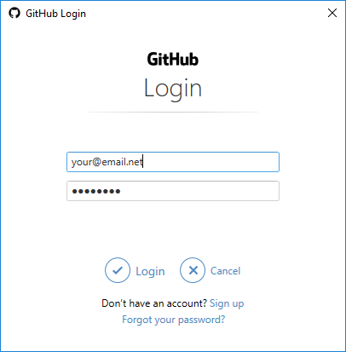

Slide 25
Create your local repository (3)
E:\git\Test> git commit -m "first commit"
[master (root-commit) fc0762f] first commit
1 file changed, 1 insertion(+)
create mode 100644 README.md
E:\git\Test> git remote add origin https://github.com/[YOUR]/[GIT_ADDR].git
E:\git\Test> git push -u origin master
Counting objects: 3, done.
Writing objects: 100% (3/3), 213 bytes | 213.00 KiB/s, done.
Total 3 (delta 0), reused 0 (delta 0)
To https://github.com/lifove/Test.git
* [new branch] master -> master
Branch 'master' set up to track remote branch 'master' from 'origin'.
E:\git\Test>
Now, you've pushed your local git into the remote git in Github!!

Slide 26
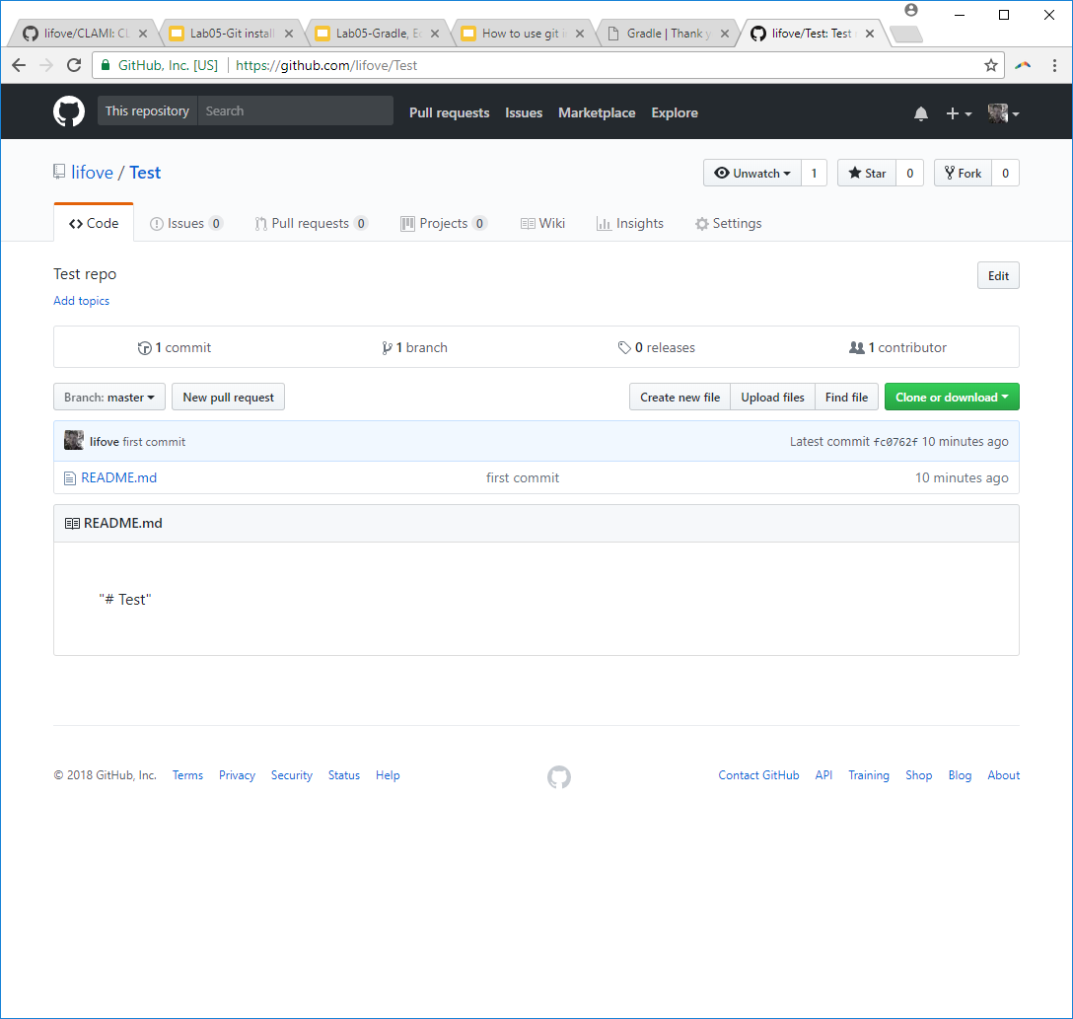
Create your local repository (4)
Check what happens in Github

Slide 27
Fork (Copy a repository from other developers) Not pork….

Slide 28

Forking a repository
You can fork to bring some source codes from other repository into your repository, without affecting the original repository.
We are going to fork this repository. ↓
https://github.com/lifove/CLAMI

Slide 29
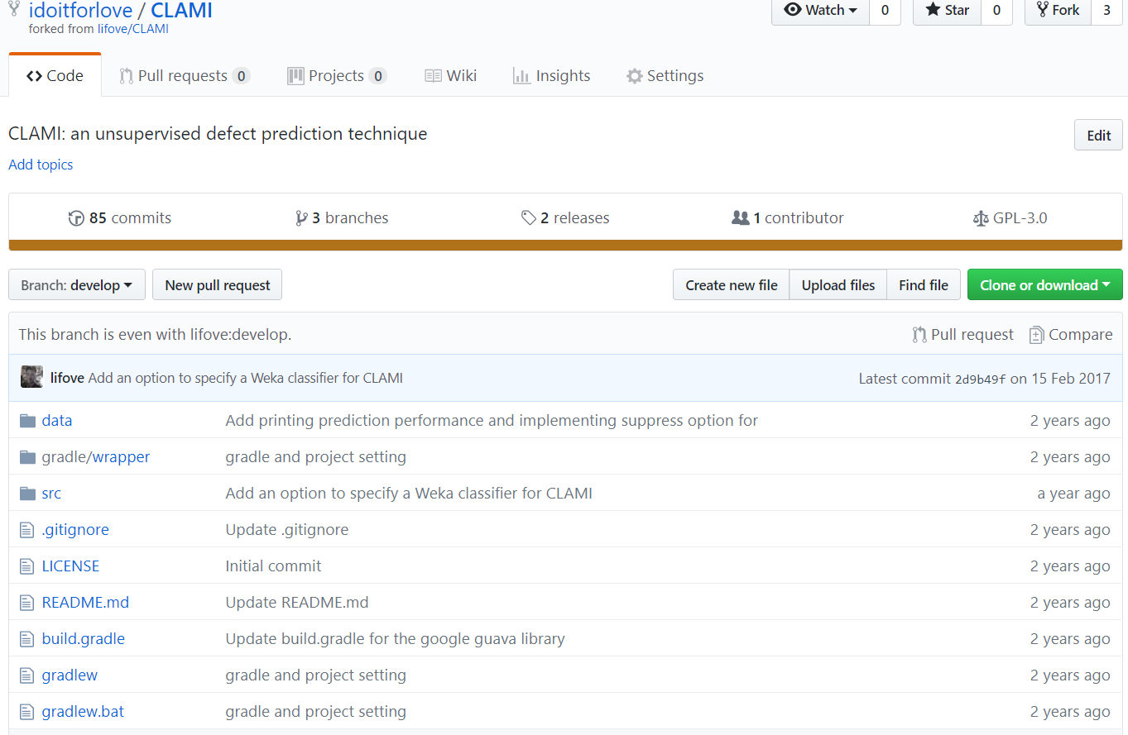
Forking a repository - result

Slide 30
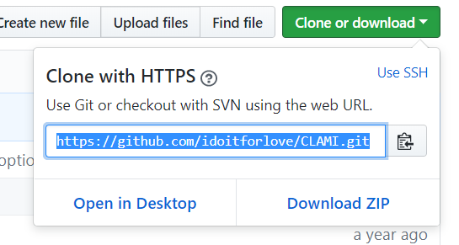
Cloning a repository - GUI
Go to your remote repository
2. And copy HTTPS

Slide 31


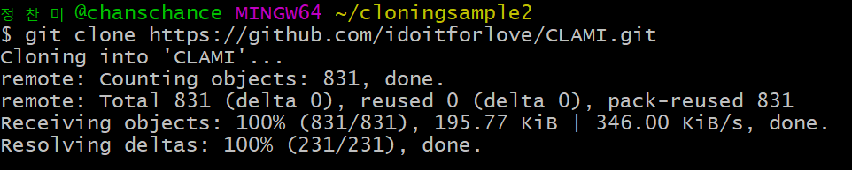
Cloning a repository - command
1. Search ‘git bash’ on your computer and click
2. Make sample directory : mkdir [directory_name]
3\
3. Change directory(in this case, cloningsample2): cd [directory_name]
4. Cloning a repository: git clone [https_address]
Please check that the operation completed successfully by checking the directory.

Slide 32
Other useful comments in git bash
$ ls // see the list of files in the current directory
$ cd cloningsample2 // move to the directory, cloningsample2 in my current directory
$ git log // see the commit history. press 'q' to exit

